Slide 1
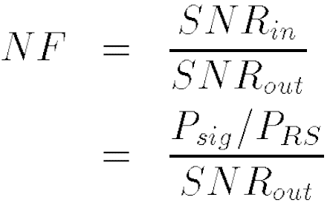

Sensitivity and Dynamic Range: Sensitivity
The sensitivity is defined as the minimum signal level that a receiver can detect with “acceptable quality.”
Noise Floor

Slide 2
Example of Sensitivity
A GSM receiver requires a minimum SNR of 12 dB and has a channel bandwidth of 200 kHz. A wireless LAN receiver, on the other hand, specifies a minimum SNR of 23 dB and has a channel bandwidth of 20 MHz. Compare the sensitivities of these two systems if both have an NF of 7 dB.
Solution:
For the GSM receiver, P_{sen} = -102 dBm, whereas for the wireless LAN system, P_{sen} = -71 dBm. Does this mean that the latter is inferior? No, the latter employs a much wider bandwidth and a more efficient modulation to accommodate a data rate of 54 Mb/s. The GSM system handles a data rate of only 270 kb/s. In other words, specifying the sensitivity of a receiver without the data rate is not meaningful.

Slide 3
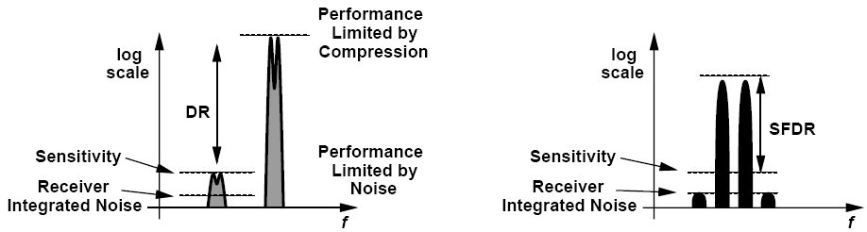
Dynamic Range Compared with SFDR
DR
SFDR
Dynamic Range:
Maximum tolerable desired signal power divided by the minimum tolerable desired signal power
SFDR:
Lower end equal to sensitivity.
Higher end defined as maximum input level in a two-tone test for which the third-order IM products do not exceed the integrated noise of the receiver

Slide 4
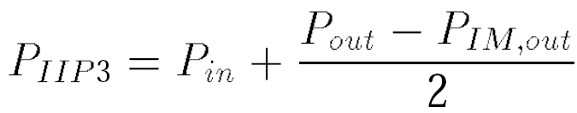


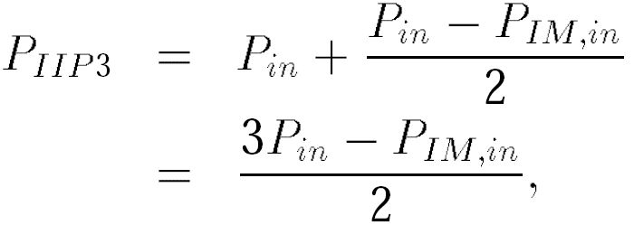
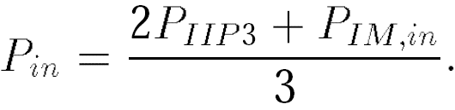
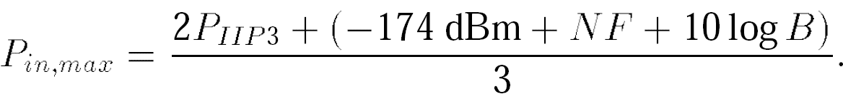
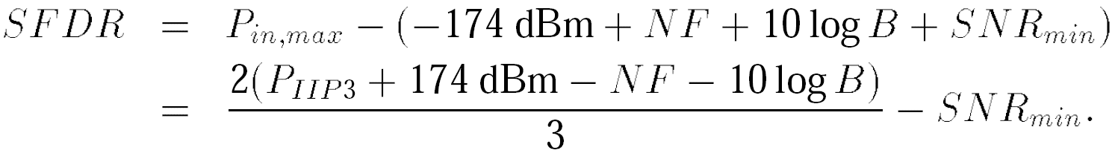
SFDR Calculation
Refer output IM magnitudes to input:

Slide 5
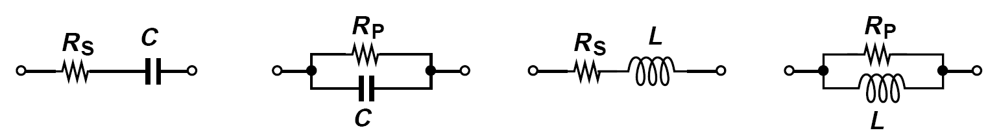
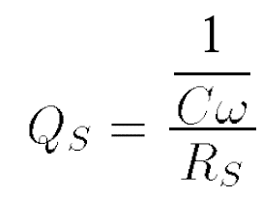
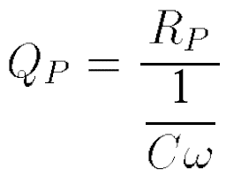
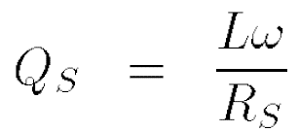
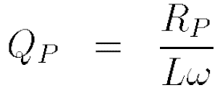
Passive Impedance Transformation: Quality Factor
Quality Factor, Q, indicates how close to ideal an energy-storing device is.

Slide 6
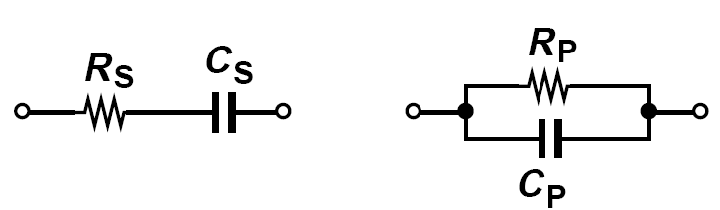
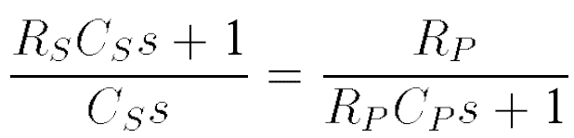
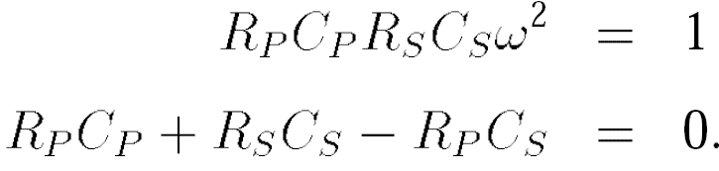
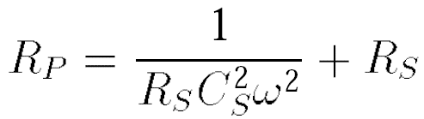


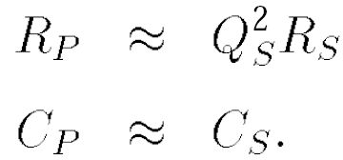
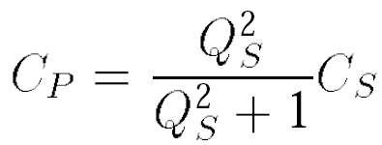
Series-to-Parallel Conversion
Q_{s}=Q_{p}

Slide 7
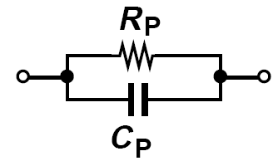
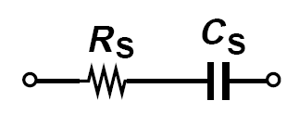

Parallel-to-Series Conversion
Series-to-Parallel Conversion: will retain the value of the capacitor but raises the resistance by a factor of Q_{s}2
Parallel-to-Series Conversion: will reduce the resistance by a factor of Q_{P}2

Slide 8
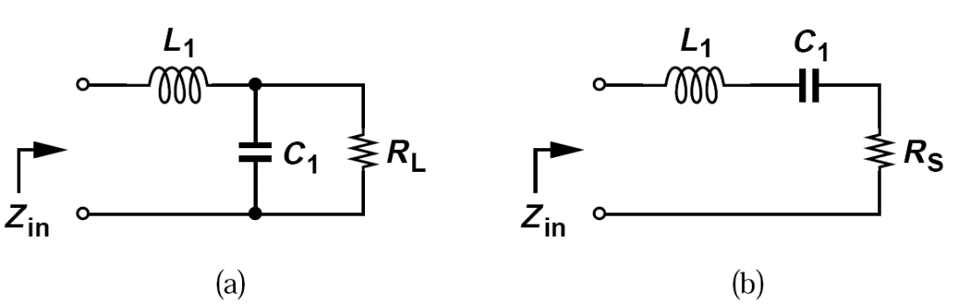
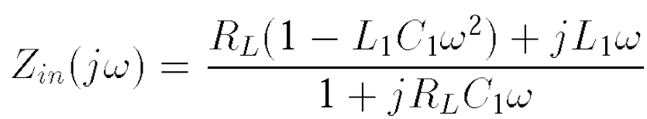
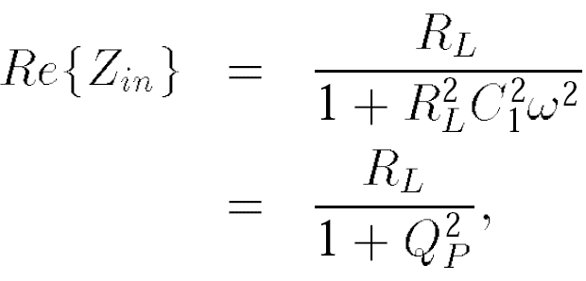
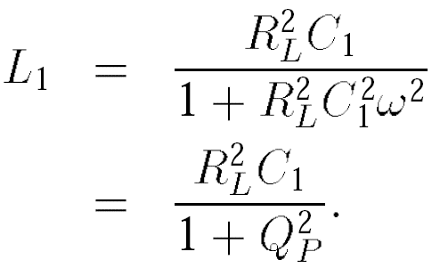

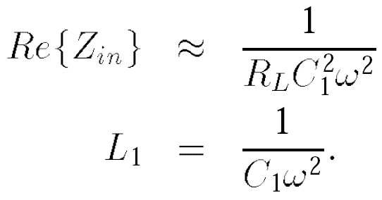
Basic Matching Networks
Thus,
R_{L} transformed
down by a factor
Setting imaginary part to zero
If

Slide 9
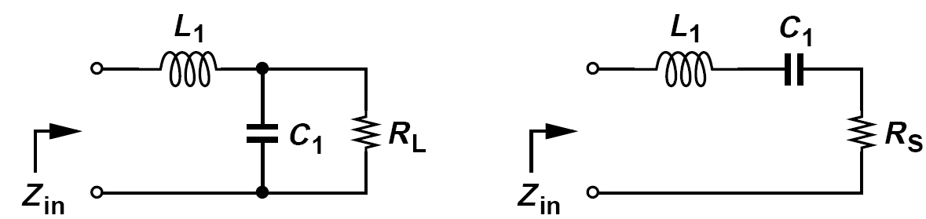
Example of Basic Matching Networks
Design the matching network of figure above so as to transform R_{L} = 50 Ω to 25 Ω at a center frequency of 5 GHz.
Solution:
Assuming Q_{P}2 >> 1, we have C₁ = 0.90 pF and L₁ = 1.13 nH, respectively. Unfortunately, however, Q_{P} = 1.41, indicating the Q_{P}2 >> 1 approximation cannot be used. We thus obtain C₁ = 0.637 pF and L₁ = 0.796 nH.

Slide 10
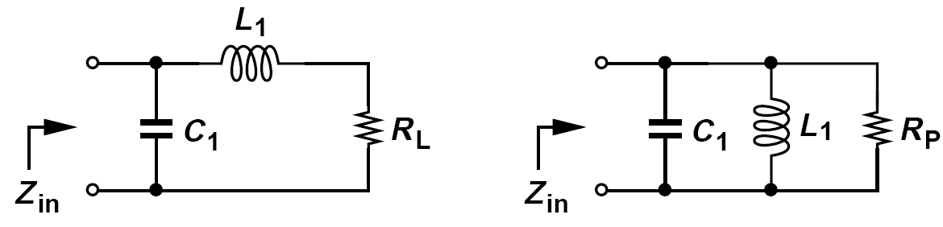
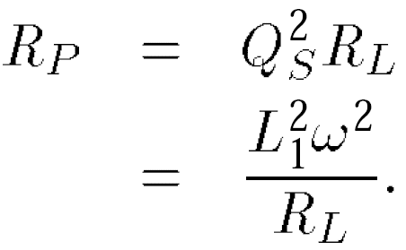
Another Example of Basic Matching Networks
Determine how the circuit shown below transforms R_{L}.
Solution:
We postulate that conversion of the L₁-R_{L} branch to a parallel section produces a higher resistance. If Q_{S}2 = (L₁ω/R_{L})2 >> 1, then the equivalent parallel resistance is
The parallel equivalent inductance is approximately equal to L₁ and is cancelled by C₁

Slide 11
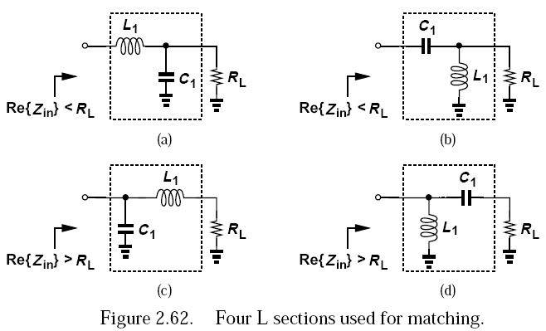
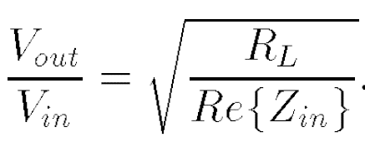
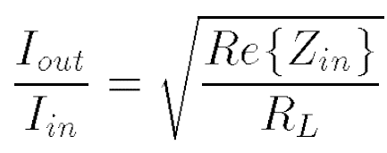
L-Sections
For example, in (a), we have:
a network transforming R_{L} to a lower value “amplifies” the voltage and attenuates
the current by the above factor.

Slide 12
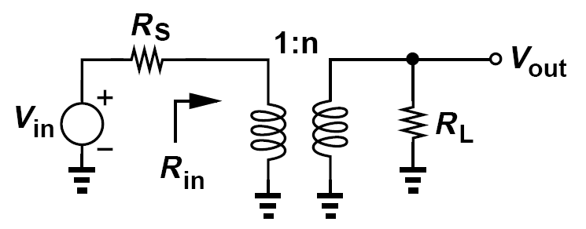



Impedance Matching by Transformers
More on this in Chapter 8

Slide 13
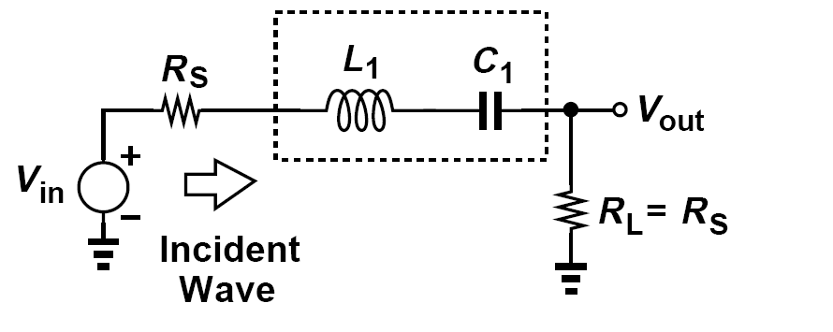
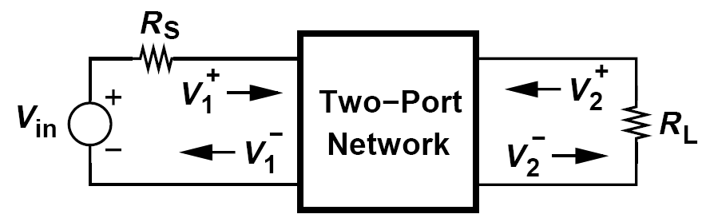
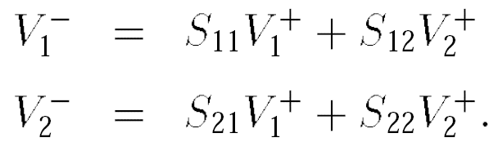
Scattering Parameters
S-Parameter: Use power quantities instead of voltage or current
The difference between the incident power (the power that would be delivered to a matched load) and the reflected power represents the power delivered to the circuit.

Slide 14
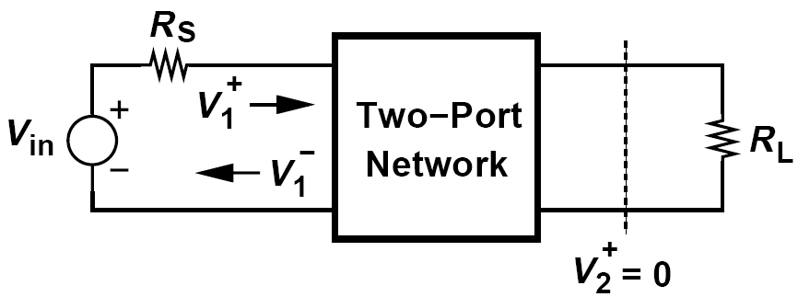
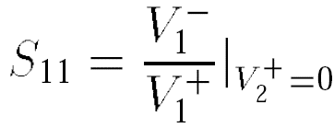
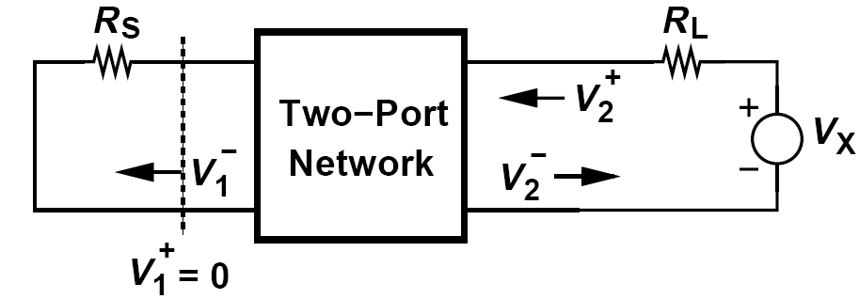
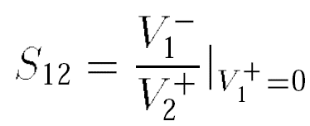
S₁₁ and S₁₂
S₁₁ is the ratio of the reflected and incident waves at the input port when the reflection from R_{L} is zero.
Represents the accuracy of the input matching
S₁₂ is the ratio of the reflected wave at the input port to the incident wave into the output port when the input is matched
Characterizes the reverse isolation

Slide 15
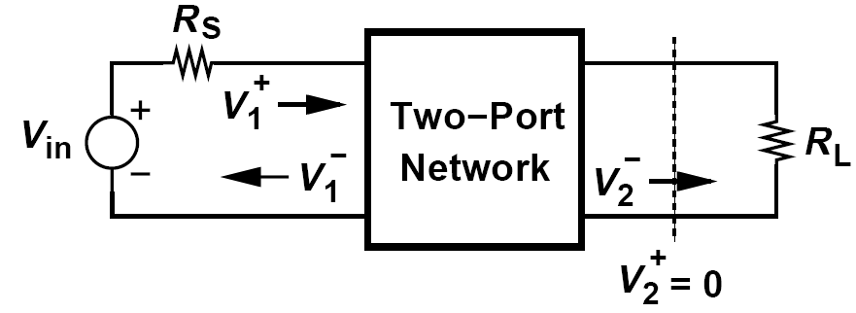
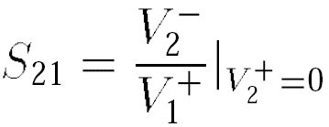
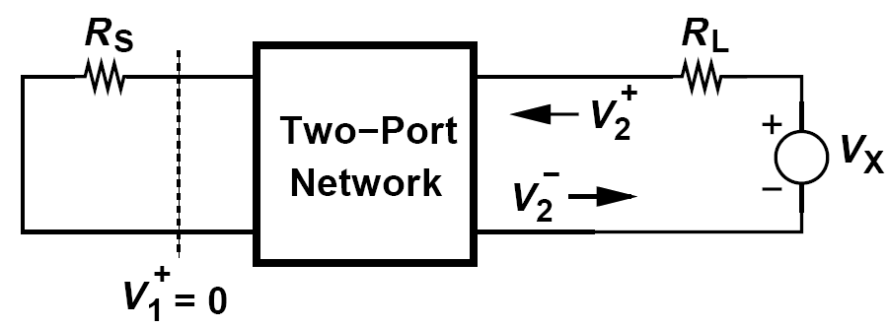
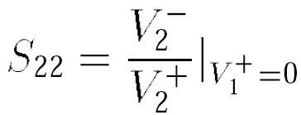
S₂₁ and S₂₂
S₂₁ is the ratio of the wave incident on the load to that going to the input when the reflection from R_{L} is zero
Represents the gain of the circuit
S₂₂ is the ratio of reflected and incident waves at the output when the reflection from R_{s} is zero
Represents the accuracy of the output matching

Slide 16
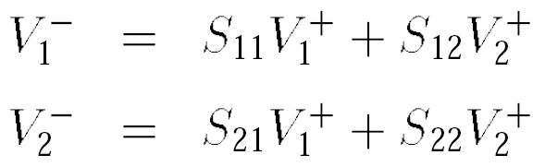

Scattering Parameters: A few remarks
S-parameters generally have frequency-dependent complex values
We often express S-parameters in units of dB
The condition V₂+=0 does not mean output port of the circuit must be conjugate-matched to R_{L}.

Slide 17
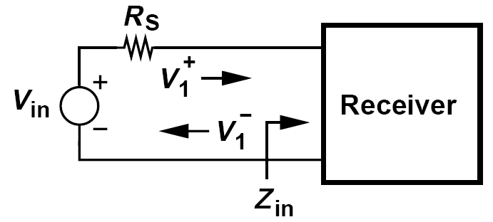
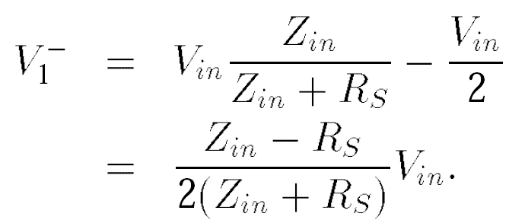
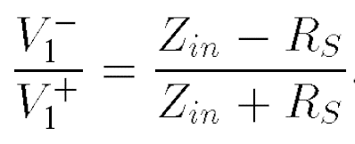
Input Reflection Coefficient
In modern RF design, S₁₁ is the most commonly-used S parameter as it quantifies the accuracy of impedance matching at the input of receivers.
Called the “input reflection coefficient” and denoted by G_{in}, this quantity can also be considered to be S₁₁ if we remove the condition V₂+ = 0

